Slide 1
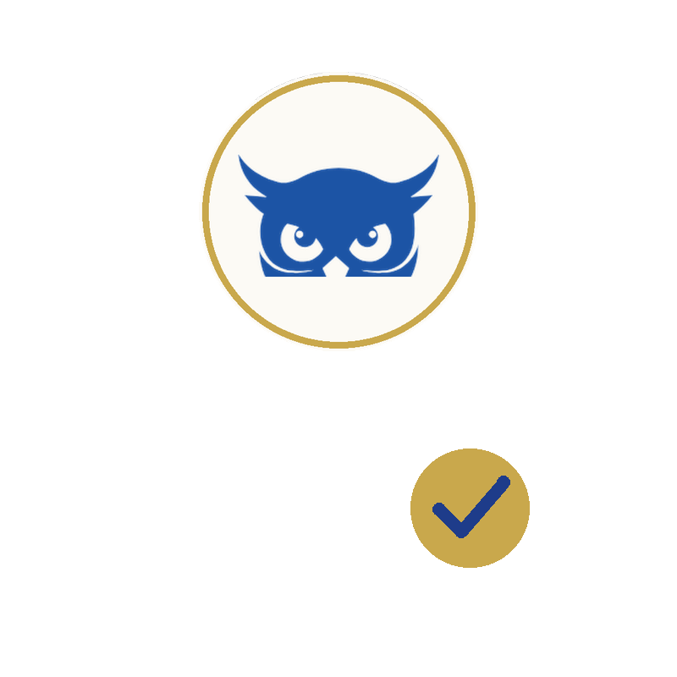

ADA SHIELD FOR LAW FIRMS
Your Practice Is an ADA Target Too.
Are You Protected?
It isn't only your clients' websites at risk — your own firm's site is exposed to the same demand letters and litigation. A complete WCAG 2.1 AA compliance system for your practice: accessibility widget, hosted legal documents, cookie consent, and a documented compliance record.
Included with Help Lawyer membership — or available directly.
adashield.org · help-lawyer.com

Slide 2


ADA SHIELD
HELP LAWYER
Accessibility Litigation Is Accelerating
Every unaligned website is a target. The volume and pace of ADA Title III filings have made this a matter of when, not if.
3,948
37%
$25K–$250K
ADA Lawsuits Filed in 2025
Surge in Filings, H1 2025
Average Defense Cost Per Case
This is the environment every unaligned small business website now operates in.
Source: ADA Title III litigation data, 2025
2

Slide 3
ADA SHIELD
HELP LAWYER
Law Firms Are Targets Too
This isn't only a client-protection issue. Your own firm's website carries the same exposure.
This is run at industrial scale
No website type is exempt
In 2025, just 16 plaintiff firms filed over 90% of all ADA website lawsuits — a small, concentrated group operating at high volume, not a scattered wave of individual complaints.
Suits target whichever sites carry unresolved, easily detected barriers — the same automated scans that find issues on a retailer's site find them on a law firm's site.
A lawsuit against your own firm is a credibility problem
The same documentation that protects your clients protects you
A demand letter naming the firm advising clients on legal risk is a different kind of exposure — reputational as well as financial.
Everything ADA Shield gives you for client sites — the widget, the statement, the audit trail — applies identically to your own firm's website.
Source: EcomBack 2025 ADA Website Compliance Lawsuit Annual Report
3

Slide 4
ADA SHIELD
HELP LAWYER
The Danger of Doing Nothing
An unaligned website isn't a passive risk. Each of these compounds the longer it goes unaddressed.
✗
Default judgment if you ignore it
Failing to respond to a filed lawsuit can result in a default judgment — the plaintiff is awarded the full damages sought, plus legal fees, with no opportunity to defend.
✗
Repeat targeting, not a one-time event
40%+ of accessibility suits target businesses that have already been sued before. Without remediation, the same exposure invites the next claim.
✗
Business disruption and diverted resources
Responding to a demand letter or lawsuit consumes owner and staff time that would otherwise go toward running the business.
✗
Reputational damage with customers and partners
A public lawsuit over excluding disabled customers is a credibility problem, not just a legal one — the kind customers and partners remember.
4

Slide 5
ADA SHIELD
HELP LAWYER
This Is What It Looks Like
The same suits filed against your clients — and, per the last slide, firms like yours — every week.
CASE EXAMPLE
CASE EXAMPLE
CASE EXAMPLE
Sticky Rice
West of Camden
Fashion Nova
Echo Park, Los Angeles — Restaurant
Huntington Beach — Clothing Retailer
National — E-Commerce Retailer
Sued after a legally blind plaintiff alleged difficulty accessing the business's website.
Sued twice over alleged website ADA violations.
Class action alleging screen-reader users could not browse or complete purchases.
Reported by ABC7 Los Angeles.
No discount for the second claim — full cost repeated.
Settled for $5.15 million — the largest such settlement on record.
Source: ABC7 Los Angeles; Manning Law Firm litigation
Source: Orange County business press coverage
Source: National Law Review, 2025
5

Slide 6

ADA SHIELD
HELP LAWYER
“There was no warning… just this lawsuit out of the blue.”
— Erin Slattery, President & CEO, Laguna Beach Chamber of Commerce
Source: Orange County business press coverage of local ADA website litigation

Slide 7
ADA SHIELD
HELP LAWYER
What a Demand Letter Actually Costs
The difference between a quick resolution and a protracted defense often comes down to one thing: documentation.
Without a Documented Compliance Record
With a Documented Compliance Record
Quick settlement to make it go away: $5,000–$25,000
Full defense through negotiation: $5,000–$125,000
40%+ of suits target previously-sued businesses — the full cost repeats
No standing to demonstrate good-faith effort if it escalates
A provable remediation history changes the negotiating position before a response is even sent
Demonstrated good-faith effort is the single factor most likely to reduce or resolve a claim early
This is what ADA Shield's Compliance Record exists to give you
Most cases settle in this range — but not all. In 2025, Fashion Nova's web accessibility class action settled for $5.15 million, the largest such settlement on record.
Source: ADA Title III litigation data, 2025; National Law Review coverage of Fashion Nova settlement
7

Slide 8
ADA SHIELD
HELP LAWYER
Why Our Seal Is Different
ADA Shield's conformance seal and accessibility statement always reflect your actual conformance status. When your site meets the relevant WCAG 2.1 AA criteria, the statement and seal read “ALIGNED” — never an unconditional “COMPLIANT” claim.
✓
ALIGNED
This isn't a hypothetical concern. In January 2025, the Federal Trade Commission ordered a major accessibility overlay vendor to pay $1 million for deceptively claiming its AI-powered product could make any website compliant, when it did not reliably deliver on that promise. We don't name the vendor here for legal reasons, but the case is a matter of public FTC record.
Stated only when your scan actually verifies it
✗
“COMPLIANT”
An unconditional claim regulators have fined vendors for making
Source: Federal Trade Commission, January 2025 enforcement action
8

Slide 9
ADA SHIELD
HELP LAWYER
One Platform. Complete Protection.
Everything you need to demonstrate conformance — configured and managed by you.
1
Accessibility Widget
2
Hosted Legal Documents
Deploy a WCAG 2.1 AA accessibility toolbar to any website in minutes — text resizing, high contrast, dyslexia font, reading guide, motor navigation.
Accessibility Statement, Privacy Policy, Terms of Service, and Cookie Policy — each hosted at a permanent URL, always current, embeddable on your own site.
3
Cookie Consent Banner
4
Audit Trail Protection
A blocking consent banner with categorized script tracking, themed to match your site, backed by a documented consent log.
Every scan, statement version, and document update is logged to a tamper-evident, append-only record — your provable good-faith effort.
9

Slide 10
ADA SHIELD
HELP LAWYER
Audit Trail Protection: Your Proof of Good-Faith Effort
Documented compliance doesn't just help you respond to a demand letter. It changes whether you get one in the first place.
Alignment scan completed
Every scan you run
Every statement or document update you publish
Every cookie consent decision logged
Every demand letter you receive and respond to
Accessibility statement published
Cookie consent banner enabled
Tamper-evident. Append-only. Nothing can be edited or deleted after the fact — which is what makes it credible as evidence.
Exportable as a single, timestamped legal exhibit — ready when you need it.
Privacy policy updated
Demand letter logged
10

Slide 11
ADA SHIELD
HELP LAWYER
An Investment, Not Just an Expense
ADA Shield's cost is treated the same as any other business expense — and may qualify for more.
Ordinary Business Expense
IRS DISABLED ACCESS CREDIT
Up to $5,000/yr
Subscription costs for compliance and business software are generally deductible as an ordinary and necessary business expense under IRS rules — the same category as any other operating tool your business relies on.
IRS Form 8826 (Section 44) lets eligible small businesses claim 50% of eligible accessibility expenditures between $250 and $10,250 — every year expenses are incurred.
Eligible: gross receipts of $1M or less, or 30 or fewer full-time employees in the prior year.
This is general tax information, not tax advice. Confirm your specific treatment with your accountant or tax preparer.
Source: IRS Form 8826, Section 44 (Disabled Access Credit)
Not tax advice. Consult a qualified tax professional to confirm your eligibility and file IRS Form 8826.
11

Slide 12
ADA SHIELD
HELP LAWYER
Up and Running in Under 10 Minutes
1
2
3
4
Request Invite
Add Your Business
Deploy the Widget
Generate Your Statement
Tell us about your organization. We review every request personally.
Enter your details — ADA Shield creates your compliance record.
Copy one code snippet into your site's header. Live instantly.
One click generates your hosted, permanent accessibility statement.
Every request is reviewed personally before access is granted — not an automated signup.
12

Slide 13
ADA SHIELD
HELP LAWYER
Two Ways to Get Protected
Help Lawyer members get Foundation tier included. Non-members can purchase directly.
HELP LAWYER MEMBER
NON-MEMBERS — ADA SHIELD DIRECT
Included
$2,497–$5,997/yr
Foundation tier at no additional cost
Accessibility widget, hosted statement, legal documents
Cookie consent, audit trail, demand letter templates
Help Lawyer member credential
Membership by application only
The same compliance suite, purchased directly at adashield.org/direct — Standard ($2,497/yr) or Managed ($5,997/yr) tiers. Every request is reviewed personally before access is granted.
No membership required to get protected.
13

Slide 14
Protect Your Practice Before the Letter Arrives.
A complete WCAG 2.1 AA compliance system for your firm and your clients — included with Help Lawyer membership, or available directly.
Join Help Lawyer
Get ADA Shield Direct
help-lawyer.com · adashield.org/direct
A Help Lawyer Network Benefit — Available to All Practices

